Slide 1
Predictive Modeling
Chapter 2: A short tour of the predictive modeling process
STA 6543
The University of Texas at San Antonio

Slide 2
A Short Tour of the Predictive Modeling Process
Chapter 2

Slide 3

Case study: predicting fuel economy
The fueleconomy.gov web site lists different estimates of fuel economy for passenger cars and trucks.
For each vehicle, various characteristics are recorded such as the engine displacement or number of cylinders. Along with these values, laboratory measurements are made for the city and highway miles per gallon (MPG) of the car.
Task: we would build a model on as many vehicle characteristics (X) as possible in order to find the most predictive model for predicting fuel efficiency (Y).

Slide 4
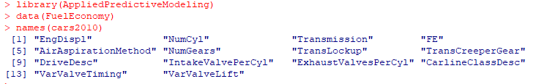
Case study: predicting fuel economy
For illustrative purposes, we focus on a single predictor, engine displacement (EngDispl), and a single response, unadjusted highway MPG for 2010–2011 model year cars.
The common terminology would be that the 2010 data are used as the model “training set” and the 2011 values are the “test” or “validation” set.

Slide 5
Case study: predicting fuel economy
install.packages(AppliedPredictiveModeling) #install this package into R library(AppliedPredictiveModeling) data(FuelEconomy) ## Format data for plotting against engine displacement ## Sort by engine displacement cars2010 <- cars2010[order(cars2010$EngDispl),] cars2011 <- cars2011[order(cars2011$EngDispl),] ## Combine data into one data frame cars2010a <- cars2010 cars2010a$Year <- "2010 Model Year" cars2011a <- cars2011 cars2011a$Year <- "2011 Model Year" plotData <- rbind(cars2010a, cars2011a) library(lattice) xyplot(FE ~ EngDispl|Year, plotData, xlab = "Engine Displacement", ylab = "Fuel Efficiency (MPG)", between = list(x = 1.2))

Slide 6
The relationship between engine displacement and fuel efficiency of all 2010 model year vehicles and new 2011 car lines

Slide 7
Model 1: Fit a single linear model and conduct 10-fold CV to estimate the error
library(caret) set.seed(1) lm1Fit <- train(FE ~ EngDispl, data = cars2010, method = "lm", trControl = trainControl(method= "cv")) lm1Fit summary(lm1Fit) #Fitted linear regression line #efficiency = 50.5632 - 4.5209*displacement #Quality of fit diagnostics par(mfrow=c(1,2)) plot(cars2010$EngDispl, cars2010$FE,xlab = "Engine Displacement", ylab = "Fuel Efficiency (MPG)") lines(cars2010$EngDispl, fitted(lm1Fit), col=2, lwd=2) Observed =cars2010$FE Predicted= fitted(lm1Fit) plot(Observed, Predicted, ylim=c(12, 70))

Slide 8
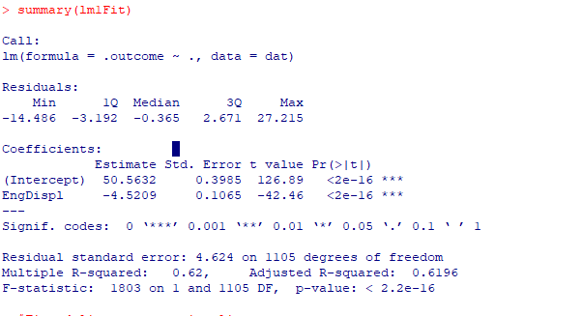
Linear model summary

Slide 9
Fit a single linear model and conduct 10-fold CV to estimate the error

Slide 10
Model 2: Fit a quadratic model and conduct 10-fold CV to estimate the error
## Create squared terms displacement =cars2010$EngDispl cars2010$displacement2 =cars2010$EngDispl^2 #quadratic term cars2011$displacement2 =cars2011$EngDispl^2 set.seed(1) lm2Fit <- train(FE ~ EngDispl + displacement2, data = cars2010, method = "lm", trControl = trainControl(method= "cv")) lm2Fit summary(lm2Fit) par(mfrow=c(1,2)) #Quality of fit diagnostics plot(cars2010$EngDispl, cars2010$FE,xlab = "Engine Displacement", ylab = "Fuel Efficiency (MPG)") lines(displacement, fitted(lm2Fit), col=2, lwd=2) Observed =cars2010$FE Predicted= fitted(lm2Fit) plot(Observed, Predicted, ylim=c(12, 70))

Slide 11
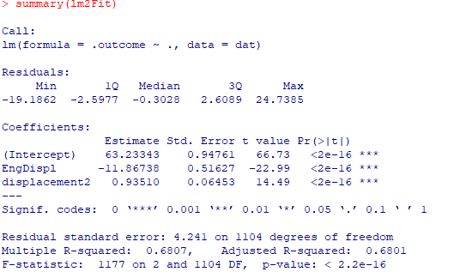
Quadratic model summary

Slide 12
Fit a quadratic model and conduct 10-fold CV to estimate the error

Slide 13
Model 3: Fit a MARS model (via the earth package)
library(earth) set.seed(1) marsFit <- train(FE ~ EngDispl, data = cars2010, method = "earth", tuneLength = 15, trControl = trainControl(method= "cv")) marsFit summary(marsFit) plot(marsFit) par(mfrow=c(1,2)) #Quality of fit diagnostics plot(cars2010$EngDispl, cars2010$FE,xlab = "Engine Displacement", ylab = "Fuel Efficiency (MPG)") lines(displacement,fitted(marsFit), col=2, lwd=2) Observed =cars2010$FE Predicted= fitted(marsFit) plot(Observed, Predicted, ylim=c(12, 70))

Slide 14
Fit a MARS model (via the earth package)
Minimum RMSE

Slide 15
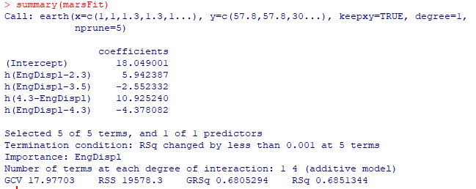
MARS model summary

Slide 16
Fit a MARS model (via the earth package)

Slide 17
Prediction performance
## Predict the test set data cars2011$lm1 <- predict(lm1Fit, cars2011) cars2011$lm2 <- predict(lm2Fit, cars2011) cars2011$mars <- predict(marsFit, cars2011) ## Get test set performance values via caret's postResample function postResample(pred = cars2011$lm1, obs = cars2011$FE) postResample(pred = cars2011$lm2, obs = cars2011$FE) postResample(pred = cars2011$mars, obs = cars2011$FE)

Slide 18
Prediction performance
Model | RMSE | R² | MAE
Simple linear model | 5.1625309 | 0.7018642 | 3.8699447
Quadratic linear model | 4.7162853 | 0.7486074 | 3.6638836
A MARS model | 4.6731291 | 0.7506505 | 3.6101626
According to your selected criteria, which predictive should be preferred for predicting fuel efficiency? Why?

Slide 19

Introduction to R
Exercise 1

